Slide 1
RSM222
Management Accounting 1
Class 10: In Class Exercise – Relevant Costing
Elisa Zuliani

Slide 2
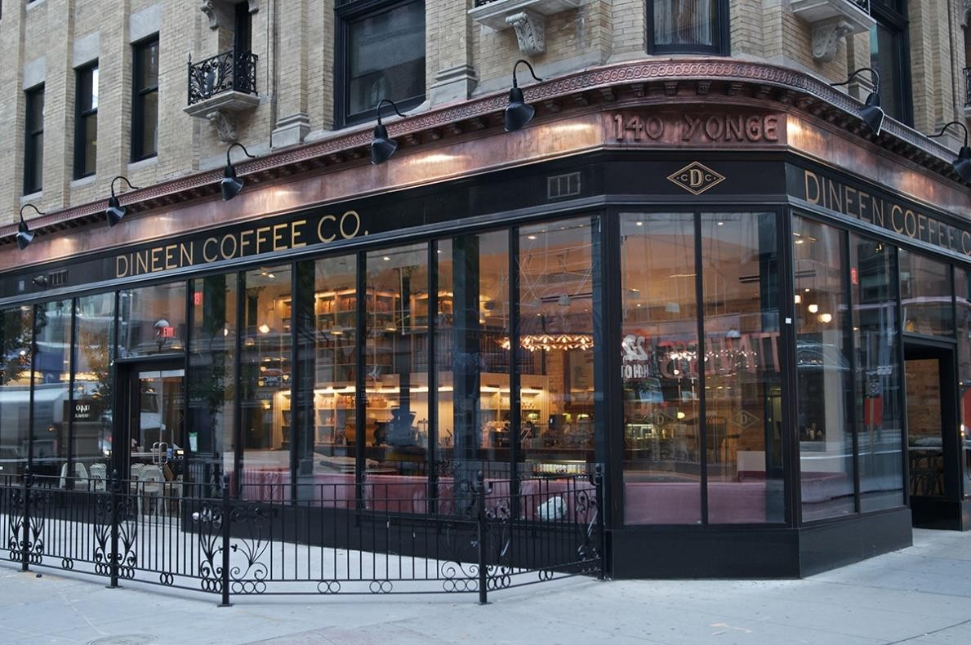
IN CLASS EXAMPLE
Belair Bistro

Slide 3
Let’s Apply: Adding or Dropping a Product Line
Belair Bistro is located in Toronto
  Made up of a sit-down cafe and a counter for take-out.
  For the past 2 years, Belair Bistro has been operating an online platform that allows customers to place orders on-line and have the food delivered in 45 minutes.
  Belair Bistro is considering dropping this segment as it is not profitable.
Fictitious but let’s assume it’s not
Should segment be dropped?

Slide 4
Situation #1 - Adding or dropping a Product Line
 | TOTAL | Café | Counter | Online Delivery
Sales | 1,675,250 | 1,125,000 | 341,250 | 209,000
Variable Costs | 1,060,500 | 689,000 | 204,700 | 166,800
Contribution Margin | 614,750 | 436,000 | 136,550 | 42,200
CM % | 37% | 39% | 40% | 20%
Fixed Expenses
Salaries | 226,850 | 189,250 | 25,600 | 12,000 | 1
Advertising | 10,000 | 7,500 | - | 2,500 | 1
Utilities | 24,500 | 18,375 | 3,675 | 2,450 | 2
Depreciation | 55,000 | 41,250 | 8,250 | 5,500 | 2
Insurance | 12,000 | 9,000 | 1,800 | 1,200 | 2
Manager Salary | 70,000 | 42,000 | 10,500 | 17,500 | 3
IT Maintenance - Delivery Platform | 16,000 | - | - | 16,000
Profit | 200,400 | 128,625 | 86,725 | -14,950
Dineen Financial Information
Note 1: Salaries and Advertising are traceable costs
Note 2: Common fixed costs are allocated based on the square footage of the building occupied by each segment.
Note 3: Manager indicated that they estimate to spend 60% of time working at the restaurant, 15% for the front desk, and 25% for the online delivery platform. The salary was allocated based on this basis.

Slide 5
Adding or Dropping a Product Line
Relevant Costs
  Lost CM = $42,200
  Avoidable Fixed Costs = $30,500
    (12,000 + 2,500 + 16,000)
  Decrease in overall company’s NI = 11,700
Qualitative
  The online service brought in new clients in the past year. Is this a sustainable trend?
  Potential opportunity costs?
 | Online Delivery
Sales | 209,000
Variable Costs | 166,800
Contribution Margin | 42,200
CM % | 20%
Fixed Expenses
Salaries | 12,000
Advertising | 2,500
Utilities
Depreciation
Insurance
Manager Salary
IT Maintenance - Delivery Platform | 16,000
Lost Profit | -11,700

Slide 6
Situation #2 - Make or Buy Decision
A competitor has offered to bake the 150 croissants Belair Bistro needs on a daily basis.
Here is the offer:
  To bake 150 croissants each day at $1.15 per unit.
  A daily delivery charge of $40 would be applied.
  Any change to the quantity ordered needs to be communicated at least 48 hours in advance.
  The current terms are valid for 1 year, at which point the contract can be renegotiated.
Should the offer be accepted?

Slide 7
Situation #2 - Make or Buy Decision
Current Costs
Direct materials: $0.95 per croissant
Variable Overhead: $0.10 per croissant.
Baker is not paid on an hourly basis, so cutting the croissant line would not affect their salary expense.
Baker believes they could make 25 pies with the time they would save. On average, the pies would provide a contribution margin of $3.5 per pie. The croissants use a special oven that could be sold. The oven was purchased 6 years ago for $8,500. It is worth about $2,500 if sold.
Should Dineen make or buy?

Slide 8
Let’s Apply: Make or Buy Decision
Buy Decision
Cost = $1.15 * 150 (cost to purchase croissants) + $40 (delivery charge)
= $212.50
Benefit = $3.50 * 25 (opportunity cost)
= $87.50 + 2,500 (ONE-TIME)
Buy Cost = $125
Make Decision:
Cost = 1.05* 150 ($0.95+ $.10)
Make Cost = $157.50
Cheaper to Buy.
Why did I not discuss Revenue?
Qualitative?

Slide 9
Situation #3 - Utilization of a Constrained Resource
Belair Bistro identified that the café’s main bottleneck is the baker’s time.
During the afternoon, the baker usually spends his time baking macarons and quiches.
Everyday, the café sells out of the boxes of macarons and quiches.
The following information about the products is provided to you:
 | Box of Macaroons | Quiche
Selling Price per Unit | $30 | $18
Variable Costs | $18 | $15
Contribution Margin | $12 | $3
The baker spends 18 minutes on each box of macarons while a quiche only requires 8 minutes
of time.
Which item should be prioritized to ensure the highest profit?

Slide 10
Situation #3 - Utilization of a Constrained Resource
Promote the products that earn the highest contribution margin in relation to the constraining
resource.
 | Box of Macaroons | Quiche
Contribution Margin | $12 | $3
Time | 18 mins | 8 mins
Contribution Margin per unit of Constrained Resource | $.67/unit | $.375`/min
What if there isn’t ample demand for both
products?

Slide 11
Any Questions?

